Slide 1

Unit 2
Abstract, interface
By. Dr. Amit.

Slide 2
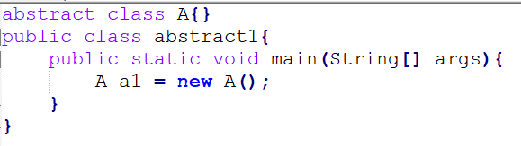
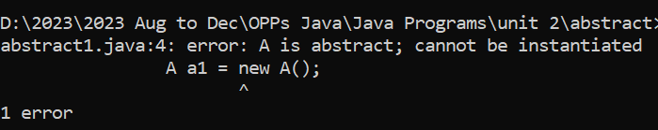
Abstract Classes
An abstract class is like a blueprint for other classes. You can't create objects directly from it, but it provides a structure for subclasses to follow.
Abstract class can have both abstract (unimplemented) and concrete (implemented) methods.
Abstract class can be declare using keyword “abstract”.
Abstract class can not be initialized (can not create an object).

Slide 3
Abstract Classes
Abstract classes can have both abstract methods or concrete methods(implemented).
Abstract methods are declared using keyword “abstract” without a method body (i.e., no implementation).
Subclasses of an abstract class are required to provide implementations for all the abstract methods declared in the abstract class.

Slide 4
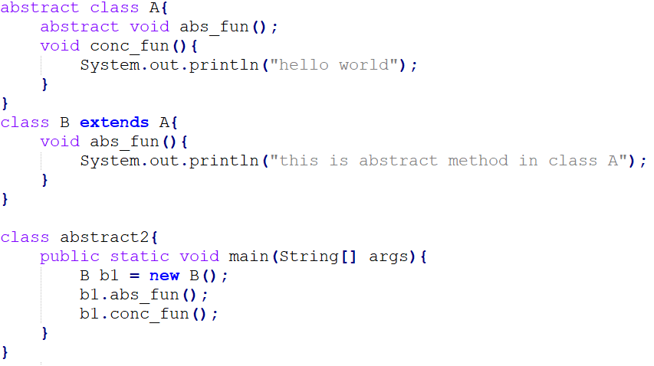


Slide 5
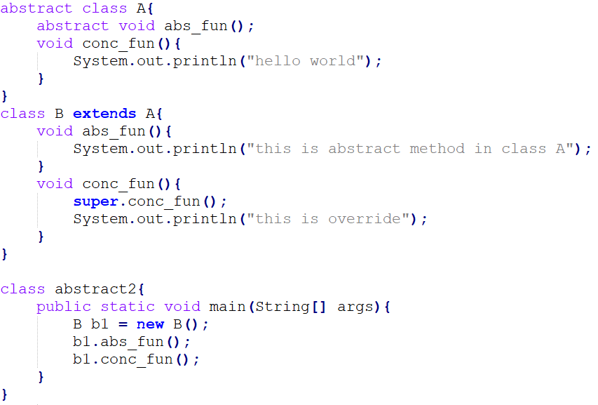

Abstract class concrete override function are accessible using “super”.

Slide 6
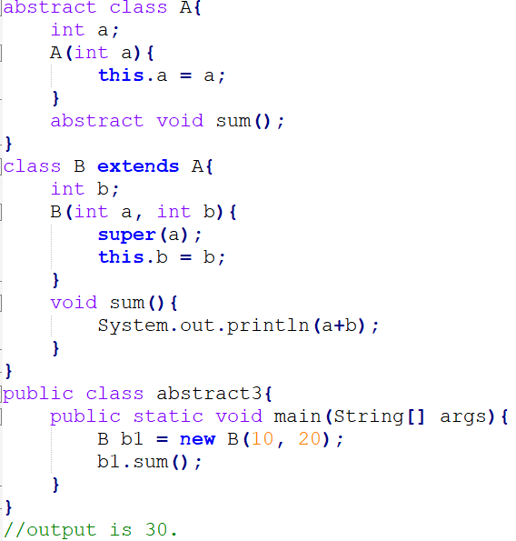
Abstract Classes
Abstract classes can have constructors, accessible using “super” keyword.

Slide 7
The Object Class
The Object class is a fundamental class that serves as the root class for all other classes.
Every class in Java implicitly inherits from the Object class. If a class does not explicitly extend another class, it extends Object by default.
The Object class defines several important methods that can be used by all Java classes.
Some of the commonly used methods from the Object class include:
equals(Object obj): Used to compare the content or state of two objects.
hashCode(): Returns a hash code value for the object, which is used in data structures like hash tables.
toString(): Returns a string representation of the object.
getClass(): Returns the runtime class of the object.
wait(), notify(), and notifyAll(): Methods used for inter-thread communication and synchronization.

Slide 8
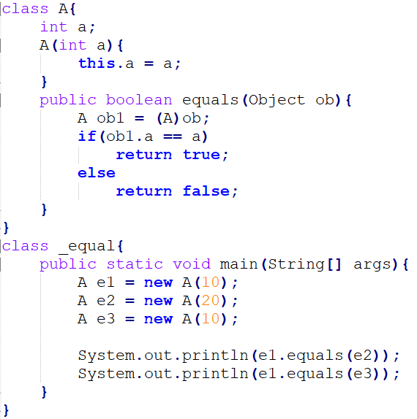

The Object class provides default implementations for these methods.
However, these default implementations may not always be suitable for your specific class, so you can override them in your custom classes to provide custom behavior.

Slide 9
Single Inheritance Vs Multiple Inheritance
Java does not support multiple inheritance to avoid the ambiguity caused by it. One example of such problem is the diamond problem.
A
A
B
A
B
C
C
B
D
Single Inheritance
Multiple Inheritance
Diamond problem: hybrid Inheritance

Slide 10
Interface
An interface is a blueprint for a class. Declared using keyword “interface”.
Interfaces can contains only method declaration, these methods are implicitly public and abstract.
Interfaces can have constants (fields), which are implicitly public, static, and final. These constants can be accessed using the interface name.
Unlike classes, Java supports multiple inheritance through interfaces.
A class must implement it using the implements keyword. The implementing class must provide concrete implementations for all of the interface's methods.
Interface can have default method (using keyword “default”).
Interface can have static method.

Slide 11
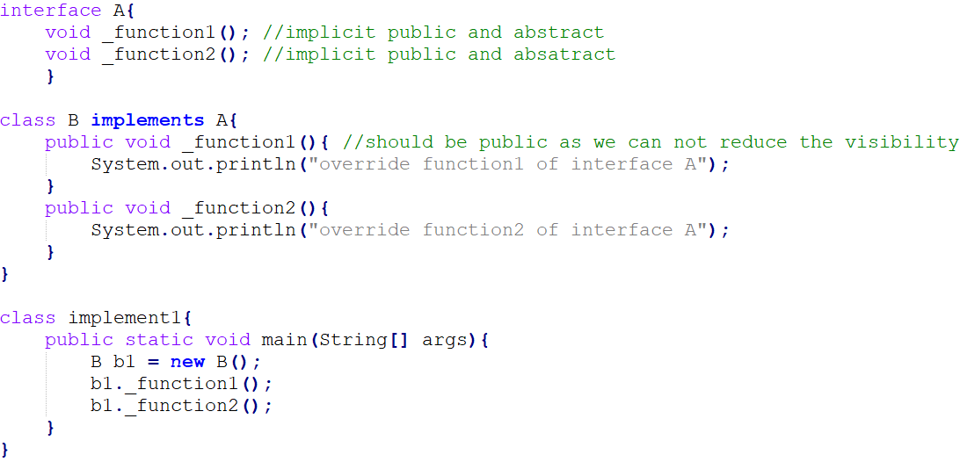

Interface Example

Slide 12
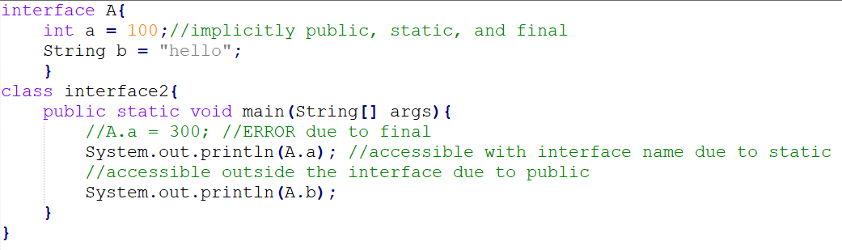
Interfaces can have constants (fields), which are implicitly public, static, and final. These constants can be accessed using the interface name.
Output
100
hello

Slide 13
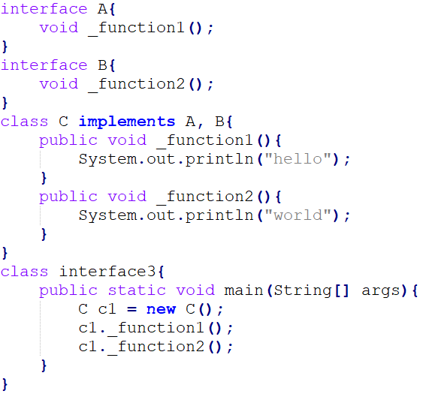
Java supports multiple inheritance through interfaces
Output
Hello
world

Slide 14
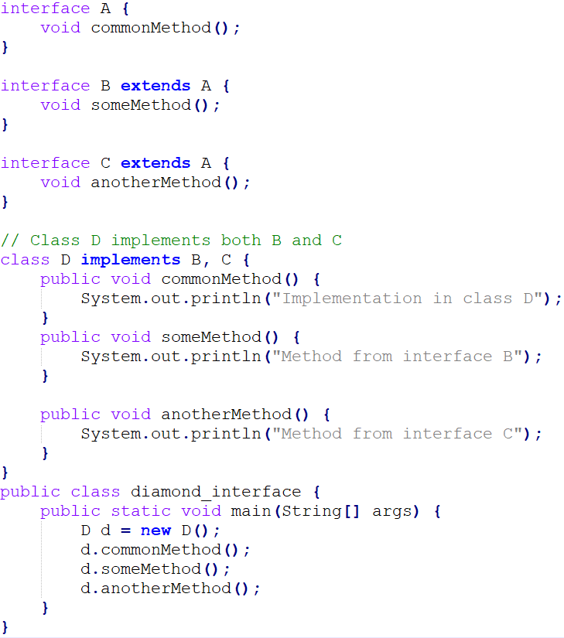
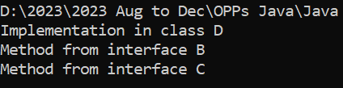
Interface resolve diamond problem

Slide 15
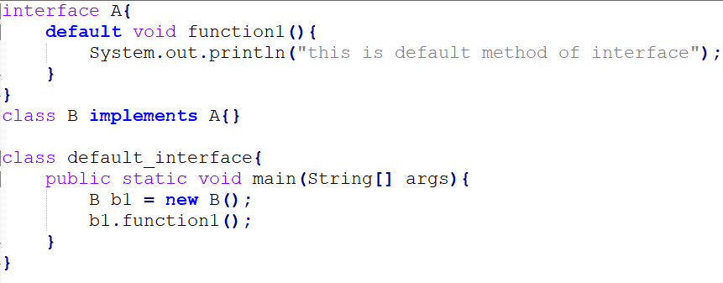
default function in interface
Output
this is default method of interface

Slide 16
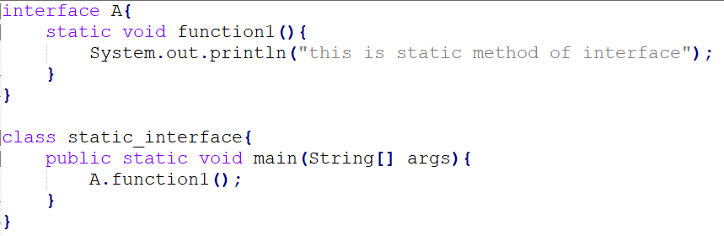
static function in interface
Output
This is static method of interface

Slide 17
Dynamic Method Dispatch
Dynamic method dispatch in Java is a feature that allows a subclass to provide a specific implementation of a method that is already defined in its superclass.
This is achieved through method overriding, and it is used to achieve runtime polymorphism.
The primary purpose of dynamic method dispatch is to achieve runtime polymorphism, where the method to be executed is determined by the type of the object, not the reference variable.
Runtime Binding, the decision about which method to call is made at runtime based on the actual type of the object.

Slide 18
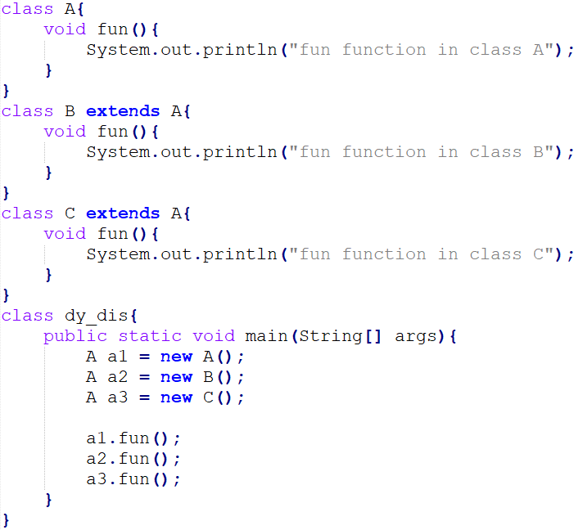


Slide 19
Accessing Implementations Through Interface References
You can declare variables as object references that use an interface rather than a class type.
Any instance of any class that implements the declared interface can be referred to by such a variable.
When you call a method through one of these references, the correct version will be called based on the actual instance of the interface being referred to.
This is one of the key features of interfaces.
The method to be executed is looked up dynamically at run time, allowing classes to be created later than the code which calls methods on them.

Slide 20
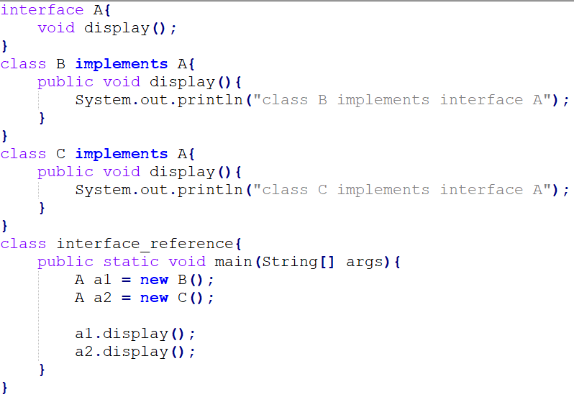


Slide 21
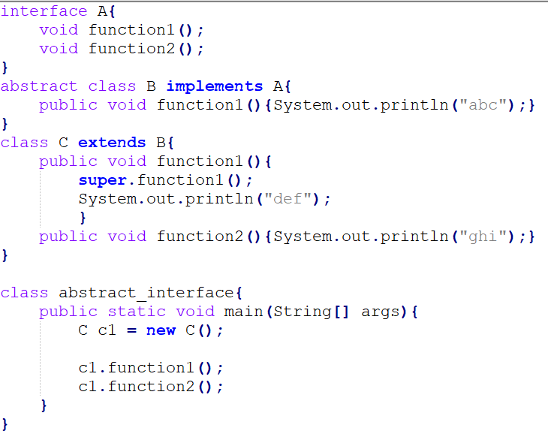

Partial Implementations
If a class includes an interface but does not fully implement the methods required by that interface, then that class must be declared as abstract.

Slide 22
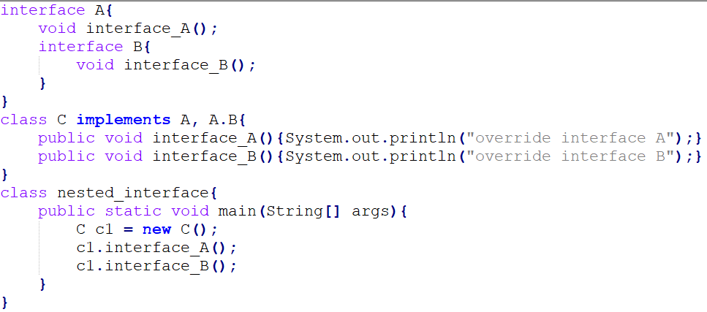

Nested Interface
A nested interface is an interface that is defined inside another interface or a class.

Slide 23
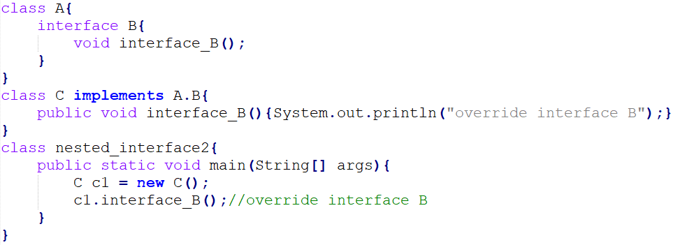
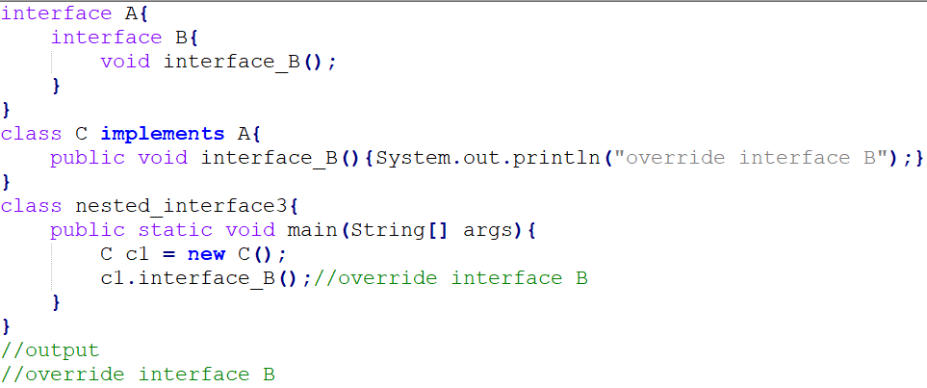

Slide 24
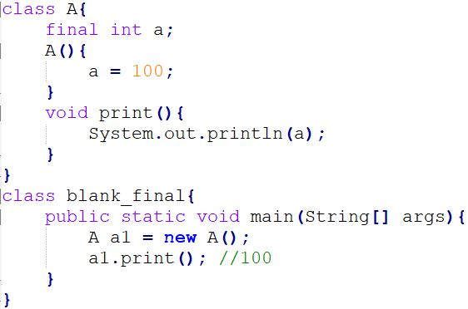
Use of “final”
Blank final variable
A final variable that is not initialized at the time of declaration is known as blank final variable. We must initialize the blank final variable in constructor of the class otherwise it will throw a compilation error.

Slide 25
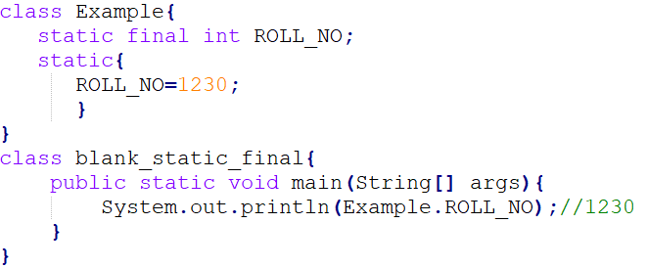
Use of “final”
Uninitialized static final variable
A static final variable that is not initialized during declaration can only be initialized in static block.

Slide 26
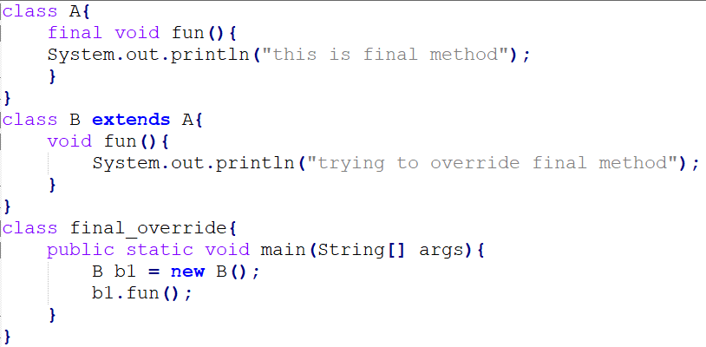
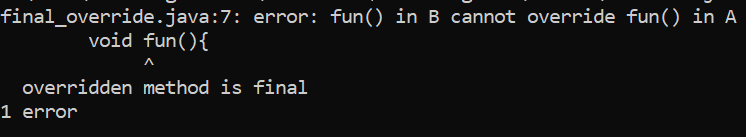
Use of “final”
Using final to Prevent Overriding
To disallow a method from being overridden, specify final as a modifier at the start of its declaration. Methods declared as final cannot be overridden.

Slide 27
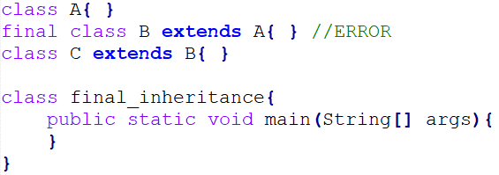
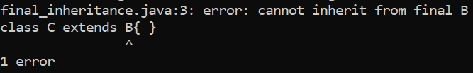
Use of “final”
Using final to Prevent Inheritance
Sometimes you will want to prevent a class from being inherited.
To do this, precede the class declaration with final. Declaring a class as final implicitly declares all of its methods as final, too.

Slide 28
Packages
In Java, a package is a way to organize and group related classes, interfaces, and subpackages.
It provides a hierarchical structure for your code, making it more organized and easier to manage, especially in larger projects.

Slide 29
Package naming
Packages are used in Java to organize classes and interfaces into a hierarchical structure. They help avoid naming conflicts and provide a way to group related code together. When naming packages, you should follow some conventions:
Hierarchical Style - Base directory then sub director …
All lowercase: Package names should be in all lowercase to follow Java naming conventions.
Avoid Confusing Names: Choose meaningful and descriptive names for your packages that reflect the content of the classes they contain.
Use of Underscores and Hyphens: Avoid using underscores or hyphens in package names; these are not allowed.

Slide 30
Type Imports
Single Type Import: Import a single type from another package, like import java.util.ArrayList;
Import All Types from a Package: Import all types from a specific package, like import java.util.*;
Static Imports: You can also import static members (variables or methods) of a class to use them without specifying the class name, like import static java.lang.Math.PI;

Slide 31
Run Time input
In Java, you can read input from the user at runtime using the `Scanner` class, which is part of the `java.util` package. Here's how you can use `Scanner` to read input from the console during program execution:
1. Import the Scanner class: import java.util.Scanner;
2. Create a Scanner object:
Scanner scanner = new Scanner(System.in);
You can now use the `scanner` object to read various types of input, such as integers, doubles, strings, etc.
3. Read input from the user:
Use methods like `next()`, `nextInt()`, `nextDouble()`, etc., to read input from the user. For example, to read a string:

Slide 32
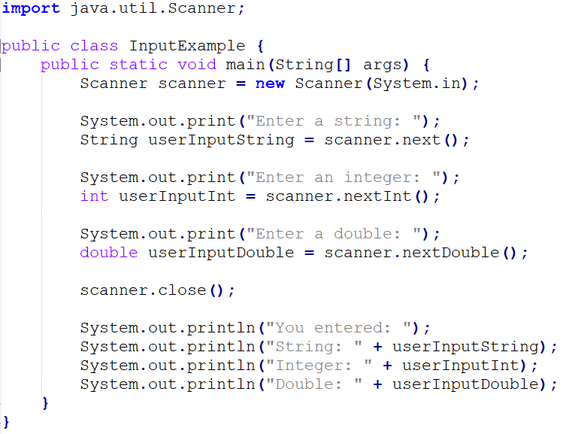
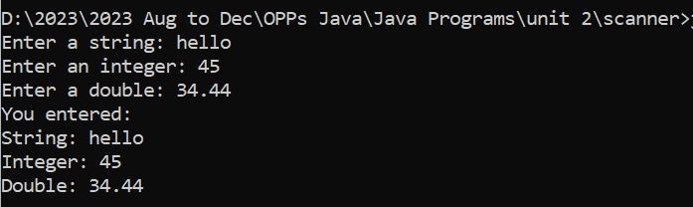

Slide 33
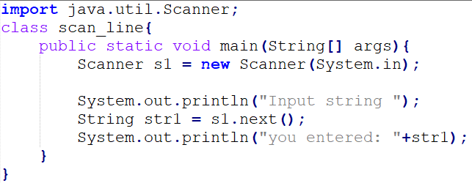
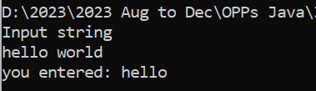
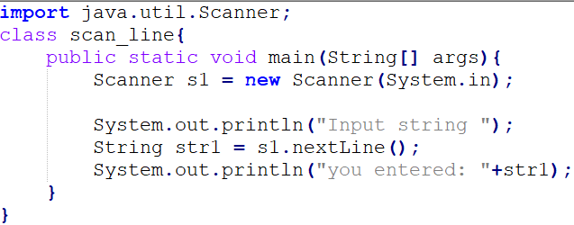
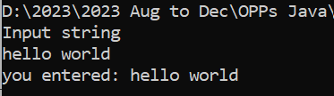
next() vs nextLine() function to input string
next() is function of Scanner class, it read the input string up to the first whitespace.
As in above program we entered “hello world” as input string but only “hello” is accepted as input.
nextLine() is also function of Scanner class, it read the input string up to the Enter Key.
As in above program we entered “hello world” as input string and “hello world” is accepted as input.

Slide 34
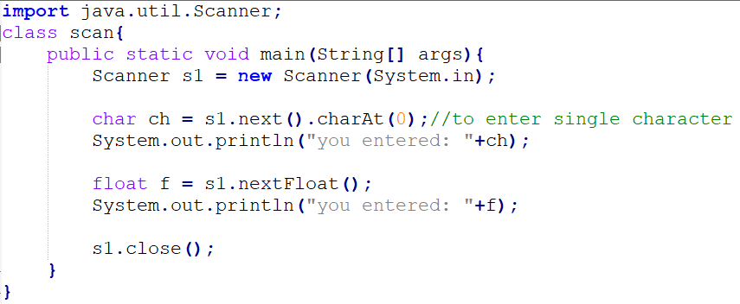
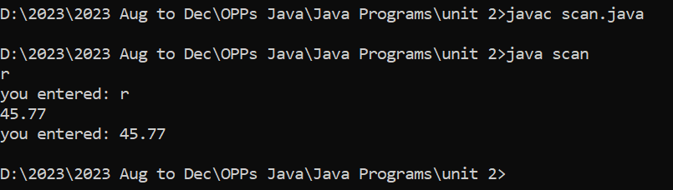
Program to input single character

Slide 35
References
Schildt, H. (2014). Java: the complete reference. McGraw-Hill Education Group.

